Slide 1
COURSERA Course for You
Trees and Graphs Basics

Slide 2
Wrapper Class
Wrapper classes are classes that allow primitive types to be accessed as objects.
Wrapper class is wrapper around a primitive data type because they "wrap" the primitive data type into an object of that class.

Slide 3
What is Wrapper Class?
Each of Java's eight primitive data types has a class dedicated to it.
They are one per primitive type: Boolean, Byte, Character, Double, Float, Integer, Long and Short.
Wrapper classes make the primitive type data to act as objects.

Slide 4
Primitive Data Types and Wrapper Classes
Data Type | Wrapper Class
byte | Byte
short | Short
int | Integer
long | Long
char | Character
float | Float
double | Double
boolean | Boolean

Slide 5
Difference b/w Primitive Data Type and
Object of a Wrapper Class
The following two statements illustrate the difference between a primitive data type and an object of a wrapper class:
int x = 25;
Integer y = new Integer(33);

Slide 6

The first statement declares an int variable named x and initializes it with the value 25.

Slide 7

The second statement instantiates an Integer object. The object is initialized with the value 33 and a reference to the object is assigned to the object variable y.

Slide 8
Clearly x and y differ by more than their values:
x is a variable that holds a value;
y is an object variable that holds a reference to an object.

Slide 9
The data field in an Integer object is only accessible using the methods of the Integer class.
One such method is intValue() method which returns an int equal to the value of the object, effectively "unwrapping" the Integer object:
int z = x + y.intValue(); // OK!

Slide 10
What is the need of Wrapper Classes?
Wrapper classes are used to be able to use the primitive data-types as objects.
Many utility methods are provided by wrapper classes.
To get these advantages we need to use wrapper classes.

Slide 11
What is the need of Wrapper Classes?
There are three reasons that we might use a Number object rather than a primitive:
As an argument of a method that expects an object (often used when manipulating collections of numbers).
To use constants defined by the class, such as MIN_VALUE and MAX_VALUE, that provide the upper and lower bounds of the data type.
To use class methods for converting values to and from other primitive types, for converting to and from strings, and for converting between number systems (decimal, octal, hexadecimal, binary).

Slide 12
Boxing and Unboxing
The wrapping is done by the compiler.
if we use a primitive where an object is expected, the compiler boxes the primitive in its wrapper class.
Similarly, if we use a number object when a primitive is expected, the compiler un-boxes the object.
Example of boxing and unboxing:
Integer x, y; x = 12; y = 15; System.out.println(x+y);
When x and y are assigned integer values, the compiler boxes the integers because x and y are integer objects.
In the println() statement, x and y are unboxed so that they can be added as integers.

Slide 13
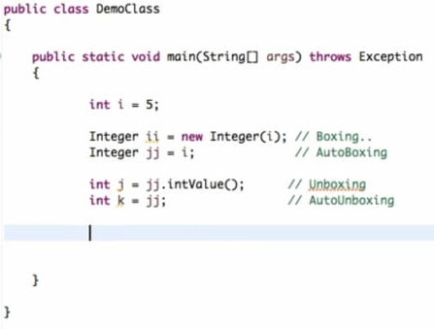


Slide 14
Unboxing
“Unboxing” means taking an Integer object and assigning its value to a primitive int.
This is done using the .intValue( ) method.
Example;
  Integer z = new Integer(7); // box
  int y = z.intValue( ); // unbox

Slide 15
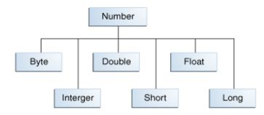
Numeric Wrapper Classes
All of the numeric wrapper classes are subclasses of the abstract class Number .
Short, Integer, Double and Long implement Comparable interface.

Slide 16
Features of Numeric Wrapper Classes
Provides a way to store primitive data in an object.
All numeric wrapper classes implement typeValue() method.
This method returns the value of the object as its primitive type.
byteValue(), intValue(), floatValue(), doubleValue() etc.
Example:
int a = 10; System.out.println(a.floatValue());

Slide 17
Features of Numeric Wrapper Classes
All the numeric wrapper classes provide a method to convert a numeric string into a primitive value.
public static type parseType (String Number)
parseInt()
parseFloat()
parseDouble()
parseLong()
…

Slide 18
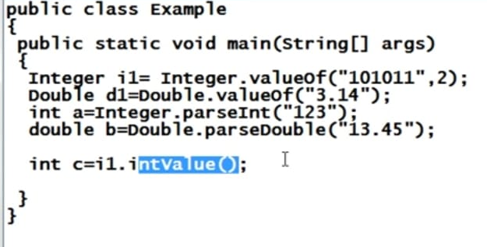

Slide 19
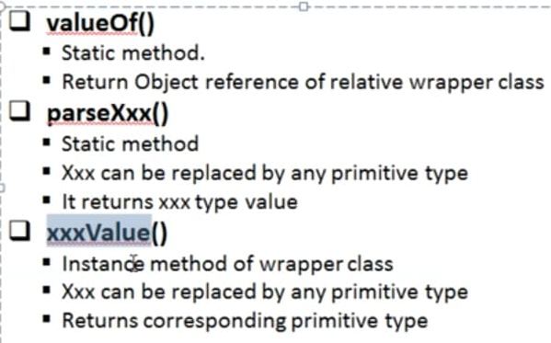

Slide 20
Features of Numeric Wrapper Classes
All the wrapper classes provide a static method toString to provide the string representation of the primitive values.
public static String toString (type value)
Example:
public static String toString (int a)

Slide 21
Features of Numeric Wrapper Classes
All numeric wrapper classes have a static method valueOf, which is used to create a new object initialized to the value represented by the specified string.
public static DataType valueOf (String s)
Example:
Integer i = Integer.valueOf (“135”);
Double d = Double.valueOf (“13.5”);

Slide 22
Methods implemented by subclasses of Number
Converts the value of the Number object to the primitive data type returned.
byte byteValue()
short shortValue()
int intValue()
long longValue()
float floatValue()
double doubleValue()

Slide 23
Methods implemented by subclasses of Number
boolean equals(Object obj)
Determines whether this number object is equal to the argument.
The methods return true if the argument is not null and is an object of the same type and with the same numeric value.

Slide 24
Instance Methods of Integer Class
byteValue() : returns the value of this Integer as a byte
doubleValue() : returns the value of this Integer as an double
floatValue() : returns the value of this Integer as a float
intValue() : returns the value of this Integer as an int
longValue() : returns the value of this Integer as a long
shortValue() : returns the value of this Integer as a short
toString() : returns a String object representing the value of this Integer

Slide 25
Character Class
Character is a wrapper around a char.
The constructor for Character is :
Character(char ch)
Here, ch specifies the character that will be wrapped by the Character object being created.
To obtain the char value contained in a Character object, call charValue( ), shown here:
char charValue( );
It returns the encapsulated character.

Slide 26
Boolean Class
Boolean is a wrapper around boolean values.
It defines these constructors:
Boolean(boolean boolValue)
Boolean(String boolString)
In the first version, boolValue must be either true or false.
In the second version, if boolString contains the string “true” (in uppercase or lowercase), then the new Boolean object will be true. Otherwise, it will be false.

Slide 27
The ArrayList Class
The ArrayList class is part of the java.util package
An ArrayList is like an array, but it automatically grows and shrinks as elements are added or deleted (so, there are never ANY empty elements in an ArrayList)
Items can be inserted or removed with a single method call
It stores references to the Object class, which allows it to store ANY kind of object – so, you can store different types in the same array

Slide 28
We cannot store primitive types (int, double, char, boolean) in an ArrayList. Instead, you would store their Wrapper Class equivalents:
  Integer
  Double
  Character
  Boolean

Slide 29
ArrayList Syntax
Import java.util.ArrayList
ArrayList is a class, so you must instantiate an object of it
If you want to add an object (such as a String) to an ArrayList, there is no special syntax. However, if you want to add a “primitive type” (such as int, double, char), you must add using a wrapper class. Commonly used ArrayList methods:
  add (obj) // adds obj at the end of the list
  add (index, obj) // adds obj at the specified index
  set (index, obj) // replaces the value at the specified index with obj
  get (index) // returns the object at the specified index
  indexOf(obj) // finds the index of the specified obj
  remove (index) // deletes the object at the specified index
  size ( ) // returns the size of the ArrayList

Slide 30
import java.util.ArrayList;
public class RemoveMethod {
public static void main(String[] args) {
// creating an ArrayList having default size 5
ArrayList<String> arr = new ArrayList<String>(5);
// Adding elements to the ArrayList
arr.add("Helen");
arr.add("Paul");
arr.add("Elanie");
arr.add("Marco");
System.out.println("The list of the size is: " + arr.size());

Slide 31
// Showing all the elements in the ArrayList
for (String name : arr) {
System.out.println("Name is: " + name);
}
// Removing element available at position 1
arr.remove(1);
System.out.println("\nAfter removing the element the size of the ArrayList is: " + arr.size());
// Showing all the elements in the ArrayList
for (String name : arr) {
System.out.println("Name is: " + name);
} } }

Slide 32
When using an ArrayList, you might get this compiler message:
filename uses unchecked or unsafe operations. Note: Recompile with -Xlint:unchecked for details.
This is just a warning, not an actual error. You can ignore it.

Slide 33
Review: static methods
A static method can be called without having to create an object.
It is called directly by using the class name (example: SavitchIn.readLine( ) )
It makes sense to make a method static when that method doesn’t have to be unique for each object that calls it.
Demo: StaticMethodClass, StaticMethodClient

Slide 34
Static variables
A variable can also be declared with the keyword static.
Just like a static method, a static variable is not accessed through an object. It is accessed by using the name of the class itself.
Why use a static variable? When that variable is not unique to each object of the class; when it is the same for all objects of the class.
Now we know where instance variables get their name: they are unique for every instance (every object) of the class.
A static variable is also known as a class variable.
Demo: StaticVariableClass & StaticVariableClient

